Slide 1
Making w/ Recycled Materials
Sculptures

Slide 2
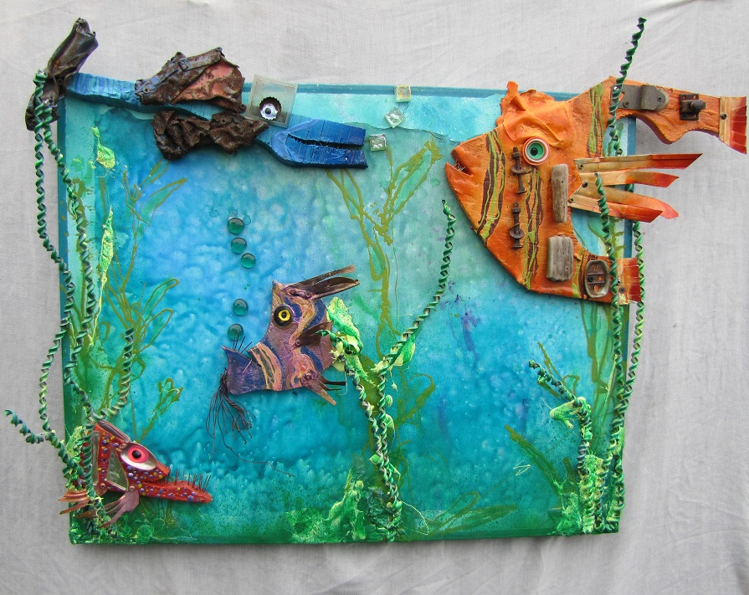
Reuse, Reduce, Recycle
A $200 billion dollar industry in the US
Generates 7-10 more jobs that landfills and waste to energy plants.
Conserve many natural resources
95% of water from mining
Prevents wastes from going into other environments (eg. ocean)
Reduces CO2 emissions and fossil fuel
By Rodney “Rodrigo” McCoubrey

Slide 3
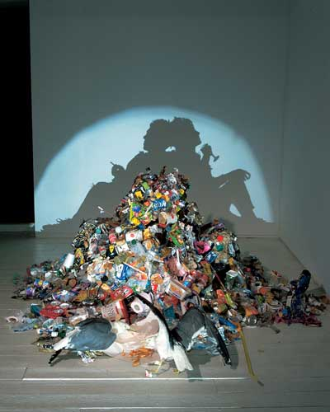
Reuse, Reduce, Recycle
Despite being only 5% of the World Population
US generates more wastes than any other nation
According to a recent Yale University/EPA study
The U.S. recycles less than 22% of discarded materials.
Recycling levels had NOT improve in the last 20 years
In about 15 years, the amount of trash will DOUBLE!
By Tim Noble & Sue Webster

Slide 4
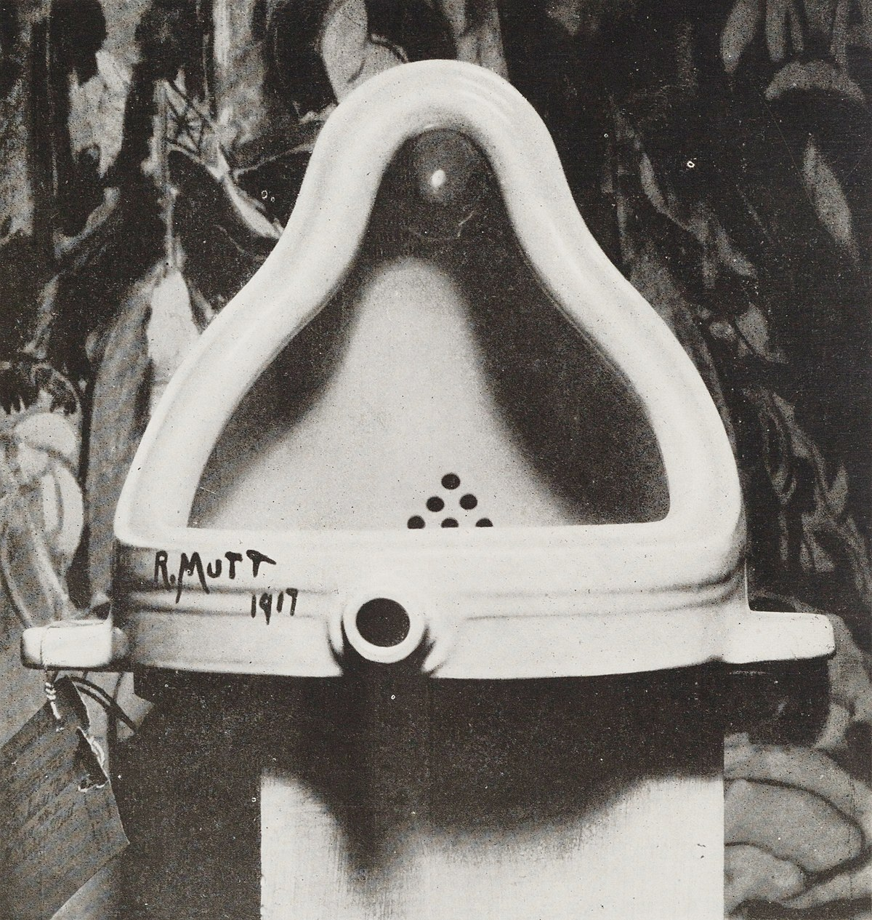
Recycle Art/Sculpture
Creating Art with Recycled/Used Materials
HIstory
Dates back with American Settlers and patching quilts
More prominent in the 20th & 21st century
Eg. Marcel Duchamp & the DADA Movement
As the world is more aware of recycling & the environment
Artist looks for ways to make trash into something beautiful
Notes:
Found object: objects made for other purposes that find their way into art

Slide 5
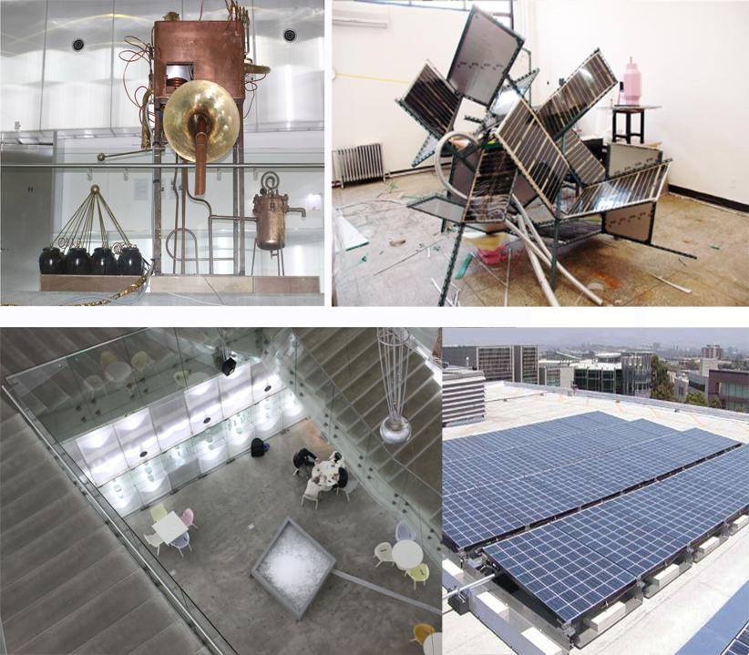
Environmental Movement
Environmental rose during the environmental movement
Of the 1970s, it often addresses ecological issues,
and artists either use items from nature
and/or recycled items that would normally go to waste.

Slide 6
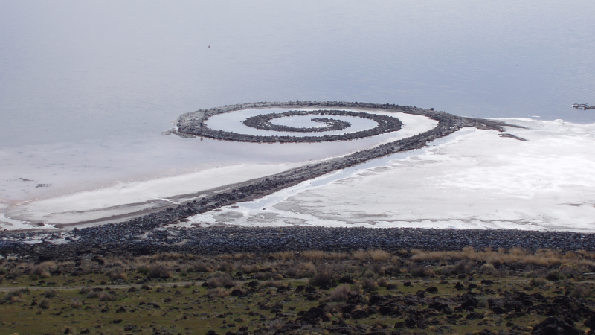
Often there’s an aspect to environmental art
That emphasizes the lack of profit made in the
works, and often the project involves more than
just the artist that came up with the idea. So most
environmental pieces become something bigger
than the artist

Slide 7
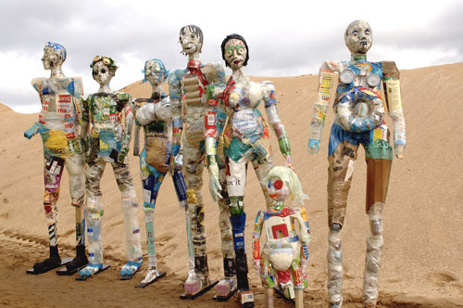
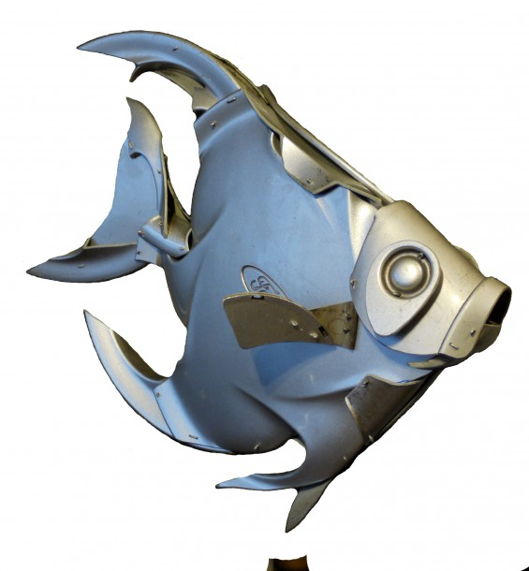
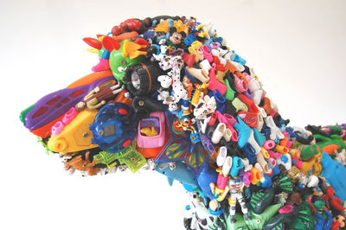
Recycled Sculpture Examples
By Michelle Reader
(Household/Industrial Waste)
By Ptolemy Elrington
(Hubcaps)
By Robert Bradford
(Trashed Toys)
Notes:
Image 1: Michelle Reader > Household + Industrial Waste
Image 2: Ptolemy (Tall-Le-ME)Elrington > Mainly Hubcaps
Image 3: Robert Bradford > Trashed Toys

Slide 8
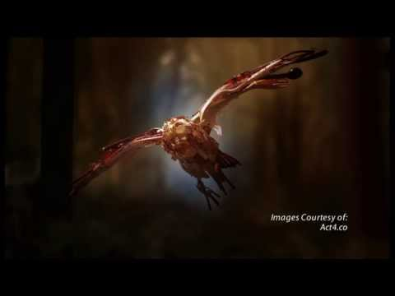
Sayaka Ganz
Notes:
STOP: 1:17
Work mainly with with plastic
Create a sense of movement and self-awareness

Slide 9
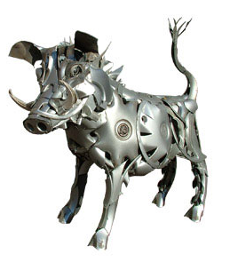
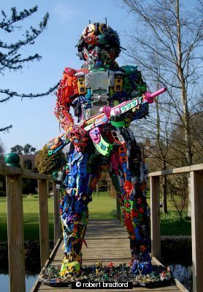
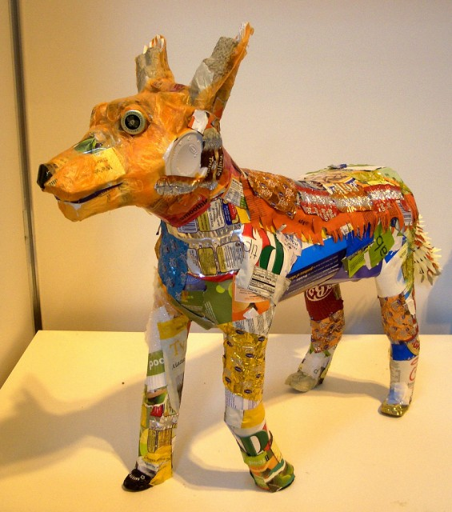
Ptolemy Elrington
Robert Bradford
Michelle Reader
Hubcaps
Toys
Household/Industrial Waste
Notes:
Mini Quiz: Guess the Artist & Materials

Slide 10
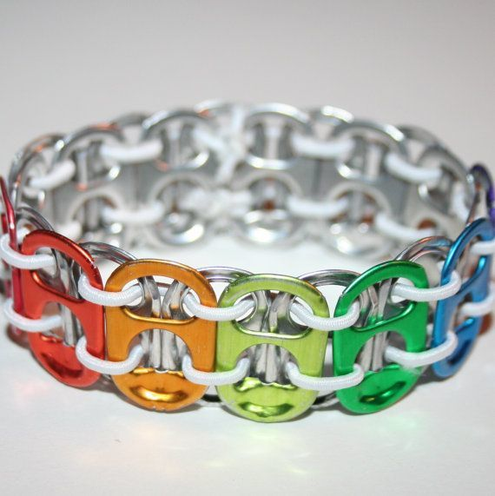
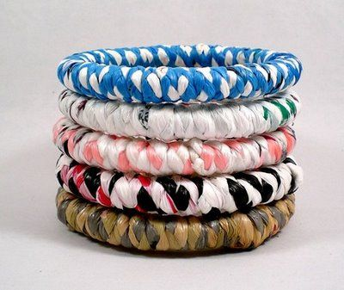
Anticipatory Set

Slide 11
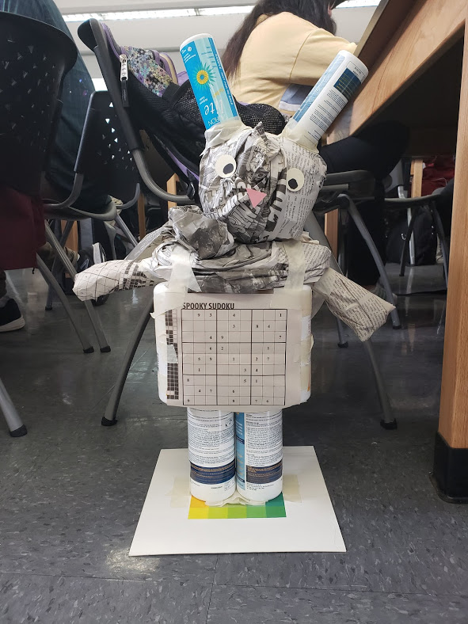
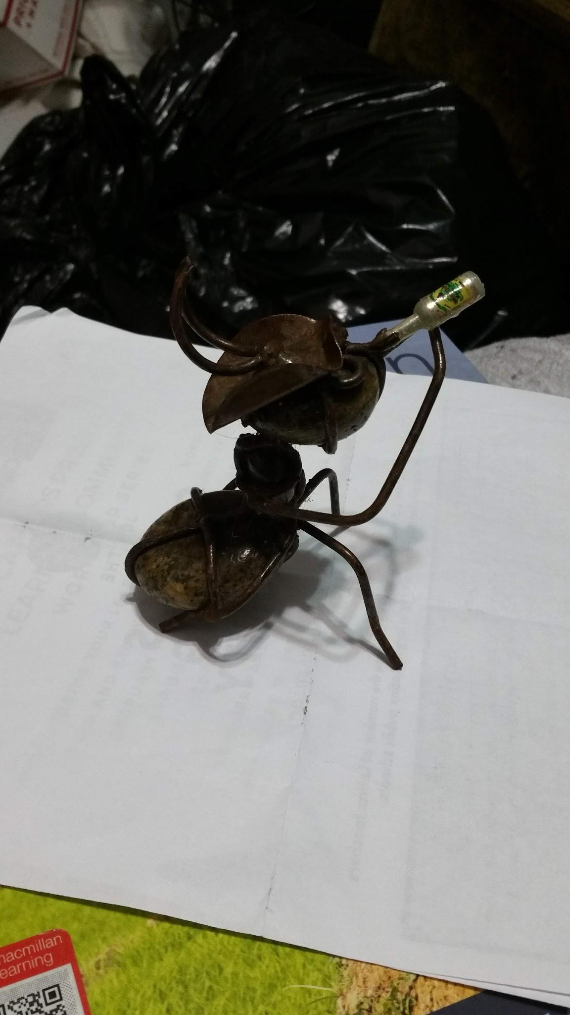
Project: Recycled Sculpture
Will make Recycled Sculpture individually
First Brainstorm
Worksheet Provide
Using the Google Art & Culture App or similar App
Gain inspiration
Refer to at least 1-2 artists
3-4 Class sessions
Recyclable materials only
Adhesive + Cutting Materials + Writing Utensils
Size: about 1ft. - 3ft.
At the end > Critique + Display
Notes:
Recyclable Materials > Can bring recyclable materials from home or from school’s environmental club
Graded: creativity, interpretation, effort,

Slide 12
Bibliography
https://www.recycleacrossamerica.org/recycling-facts
http://mentalfloss.com/article/13046/11-artists-doing-amazing-things-recycled-materials
https://sayakaganz.com/
https://study.com/academy/lesson/recycled-art-history-materials.html

